Slide 1
(Handsome Squid) planning report
Team name : God of Mobile
32122624 송현관, 32122615 김순철, 32122621 박현우

Slide 2

(1) contents
Introduction
We will Introduce about members’s charge
Finding the problem
Be going to show the 2 main thoughts building the planning
Making the solution
Be going to show the solution (cretical viewpoint)
Team Schedule & Application Consist
Be going to show the way to make this app/game and play it

Slide 3
(2) Introduction : G.O.M.
Member introduction of G.O.M.
- 송현관 : 총괄 / 주개발자
Hyun Gwan Song : total operation
main development
-김순철 : 기획 / 서브개발 / 시장조사
Soon Cheol Kim : planning with development support
market research
- 박현우 : 기획 / 서브개발 / 디자인
Hyun Woo Park : planning with development support
Application UI & resource design

Slide 4
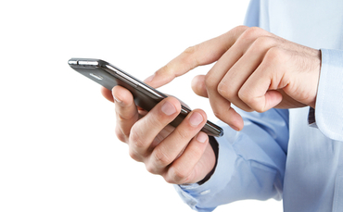
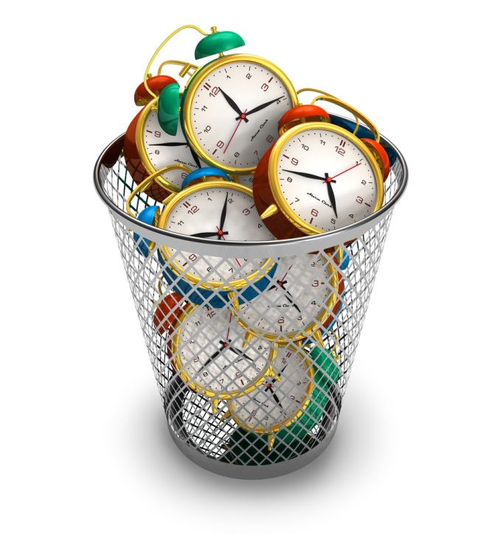
(3) Problem 1
A new Game For
Using “Spare Time”

Slide 5
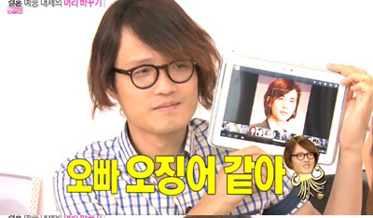
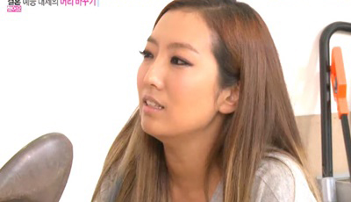
(3) Problem 2
“You are totally a squid.”

Slide 6
(4) Solution Mobile game : Cheer up everyone!
Cheer up Game!
Handsome squid

Slide 7
(4) Solution Application initial setting
Main view
Game view
Score view & Settings
Time bar
Settings
-sound
-speed
Main
image
Background
to play game
Score viw box
: From large score
to low score
Play the game button
Go to the setting view
User’s
energy
Go back button
Item
box

Slide 8
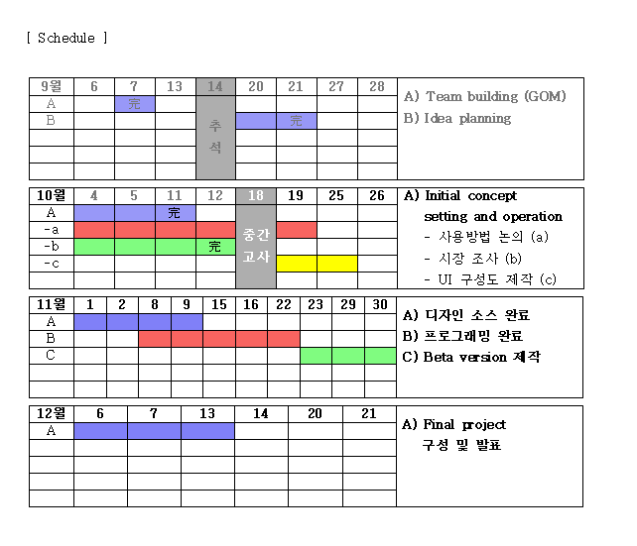
(5) Schedule

Slide 9

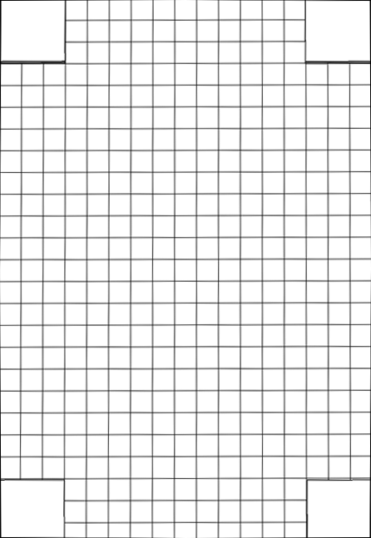



(5) Application View (simple ver)
Ⓐ Protect ideal girl on
middle of screen
from blue men who
appear randomly
Ⓑ Click the blue men
(well face guys).
Ⓒ they change into
‘squids’ and are gone
Ⓓ If you make them
disappear all until
time is over
then, mission is
completed
Ⓔ You can get great
accomplishment as
degree.
+) Item
- positive effect
: time increase.
- negative effect
: time decrease.
+) the way of level
development
: making different way
to finish game.
♥

Slide 10
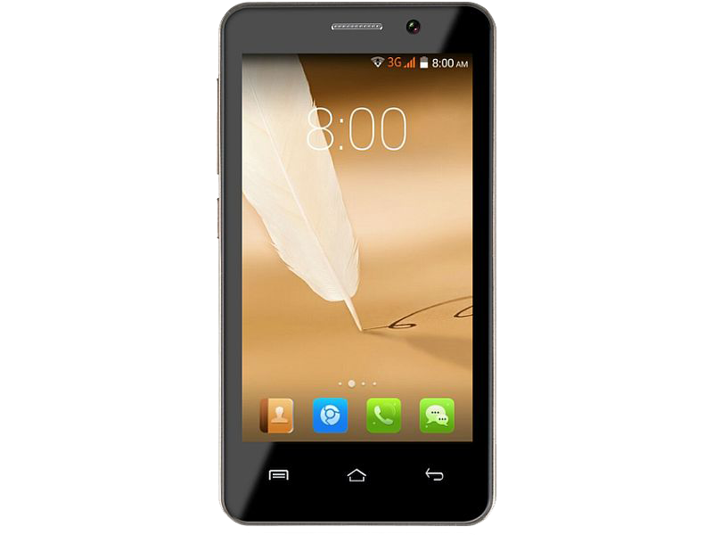

(5) Application View (simple ver)
Handsome Squid
Accomplishment of Game
1 To give ‘tickt’ to be able to date with girl
2 To give ‘chance’ to talk with idole/actor

Slide 11
Thank you very much

